Slide 1
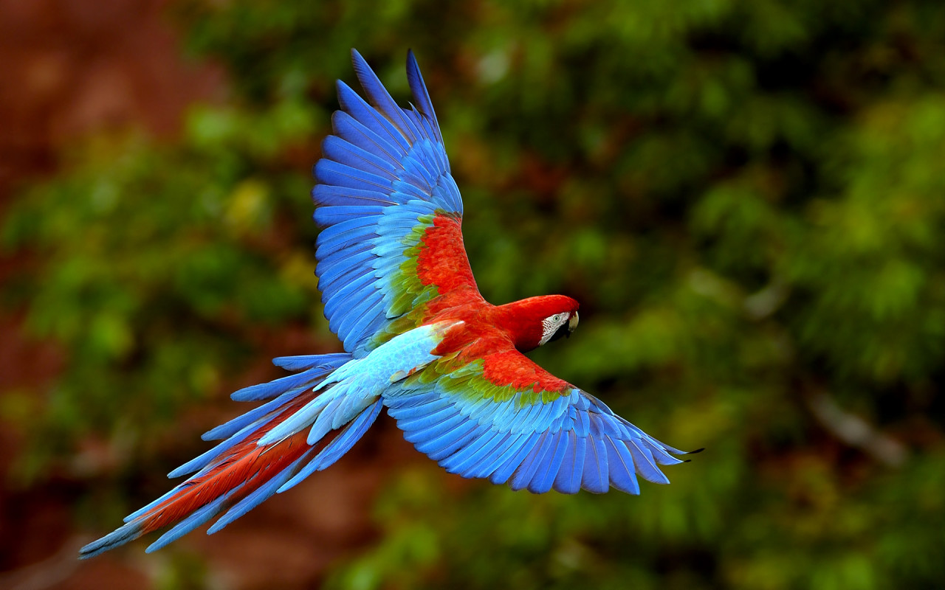
Welcome

Slide 2
Note for the honourable teachers:
The subject teachers are requested to read the notes given below the slides.
Notes are given bellow the slide no. 4, 10 ,16 and 20 .
Note for the honourable teachers:
This content may be too long as lesson’s activities are many. If it is too long, it can be taken in two periods.

Slide 3
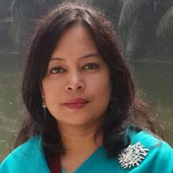
INTRODUCTION
SUBJECT: English 1st Paper
CLASS: Six
Period: One
Prepared by
ROUFUN NAHAR
Assistant Teacher( English)
Majida Govt. High School
Tongi, Gazipur.

Slide 4
Let’s see a video.
What have you seen in the video?
A Baya Weaver (Babui pakhi) is building nest.
Notes:
Showing the video teacher can ask the question to the whole class. SS will raise their hands. Teacher can ask 2/3 students to narrate what they have seen in the video.

Slide 5
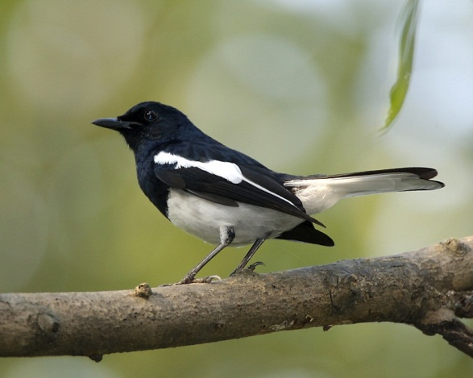
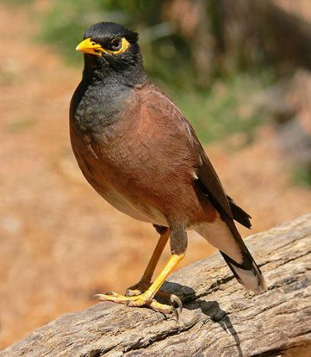
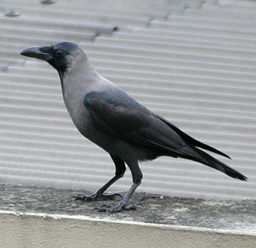
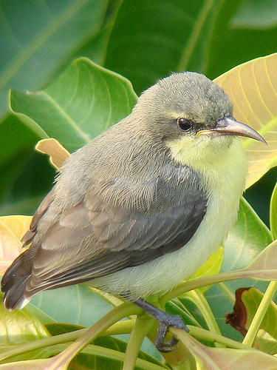
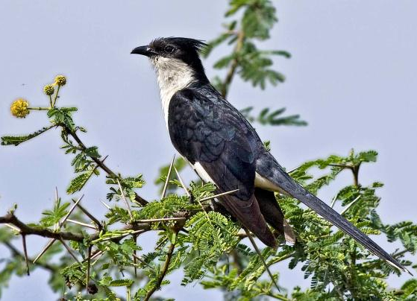
Can you tell the names of the following birds?
1
2
3
Magpie Robin
Shalikh/Myna
Crow
4
5
Tuntuni/Tailorbird
Cuckoo (Kokil)

Slide 6
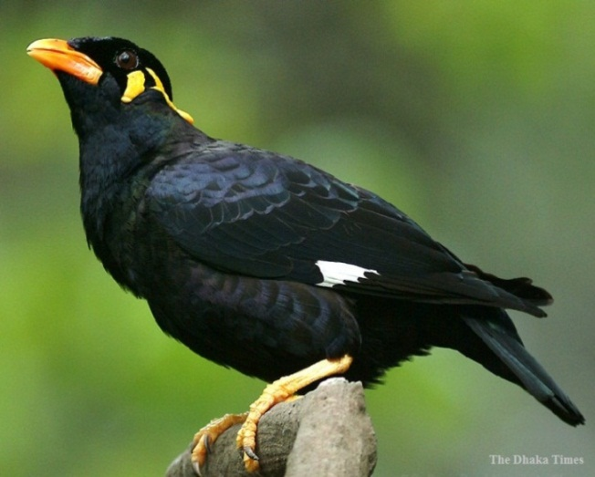
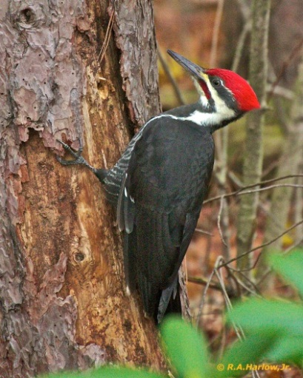
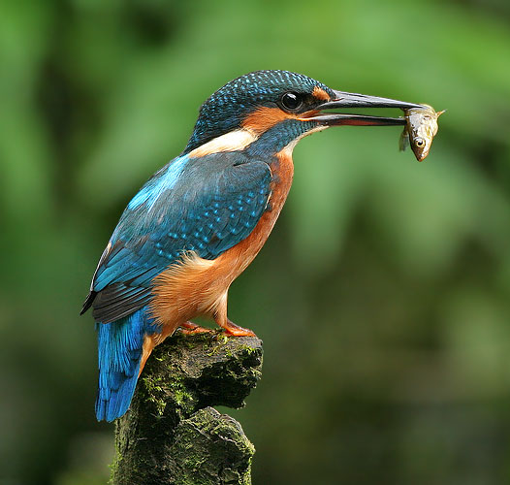
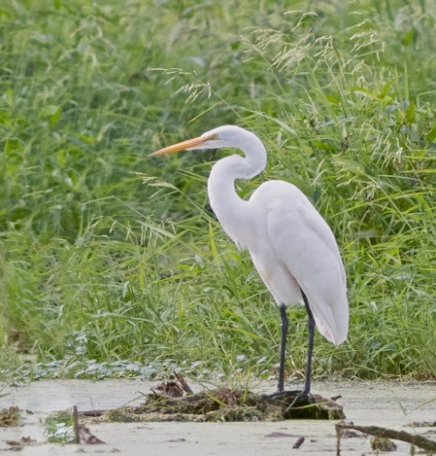
6
7
Moyna
Woodpecker
8
9
Kingfisher
Heron

Slide 7
Today our topic is
Birds of Bangladesh
Lesson- 12
Page- 37

Slide 8

OBJECTIVES OF THE LESSON
By the end of the lesson the students will be able to
Talk about the video and pictures. (Speaking skill)
Read and understand text. (Reading skill)
Write answers to questions. (Reading skill)
Write a short paragraph. (Writing skill)
Tell the meaning of some key words from the inference. Vocabulary(Plentiful, Fauna, Sprightly, Pleasant)

Slide 9
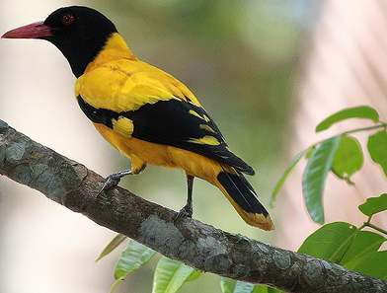
Can you tell the name of this bird?
Blackheaded Oriole
(Benebau)

Slide 10
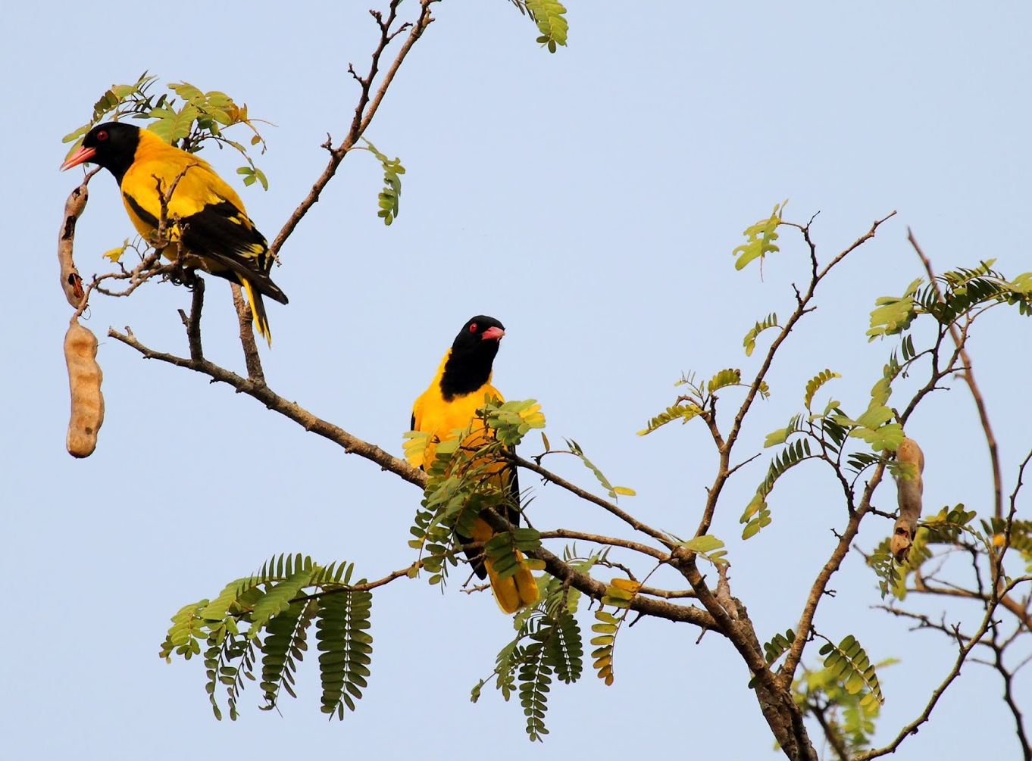
Describe the picture.
Notes:
Showing the picture teacher can ask the question to the whole class. SS will raise their hands. Teacher can ask 2/3 students to narrate the picture.

Slide 11
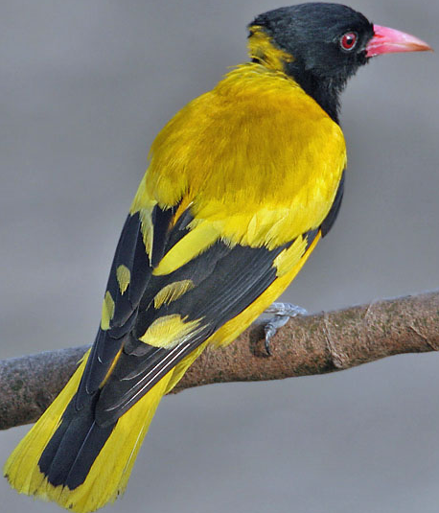
What is the colour of its beak?
What is the colour of its body?
Red
Yellow
What is the colour of its throat, tail and some part of its wings?
Can you guess what is the length of this bird?
Black
25cm

Slide 12
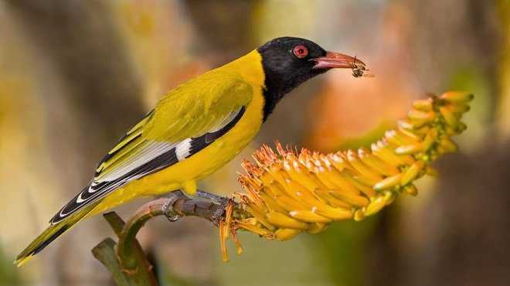
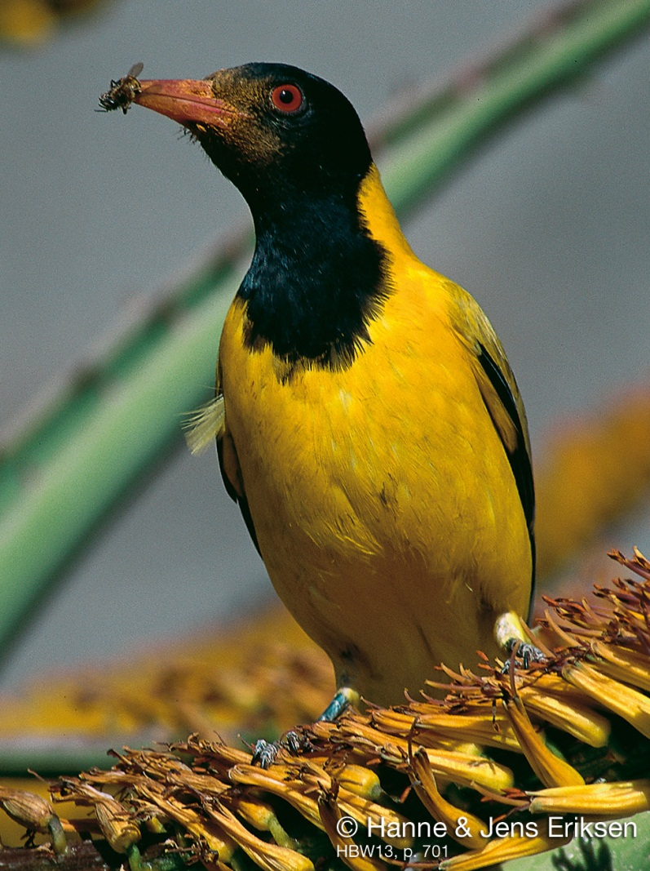
Guess what does this bird eat?
All kinds of insects and worms

Slide 13
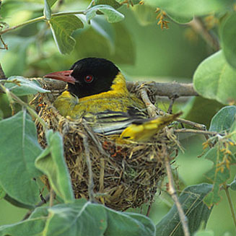
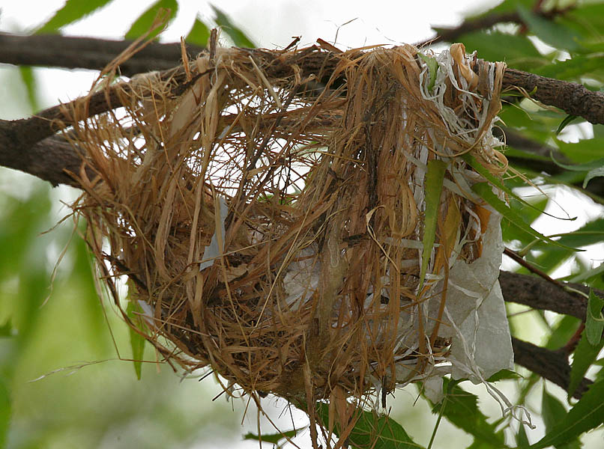
Can you guess by which the nest is made of ?
Dry grass and barks of trees.

Slide 14
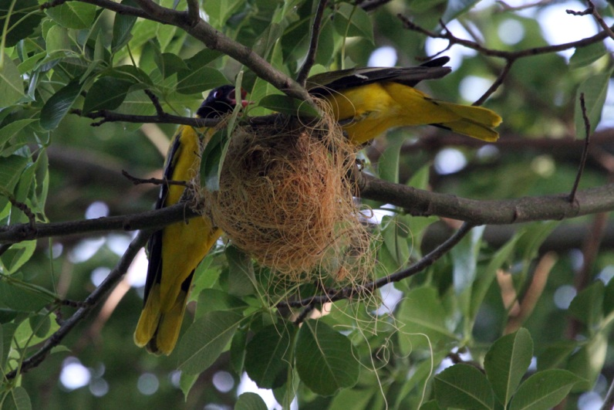
Both the male and female birds build their nest.

Slide 15
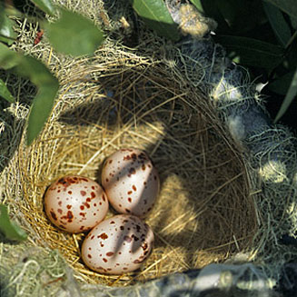
The black headed Oriole lays two or three eggs at a time.

Slide 16
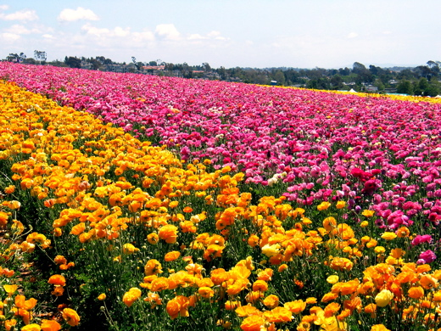
Word meaning
Plentiful
(Adjective)
Here we can see a plentiful flowers.
A lot of
Notes:
First, the word can be shown. The SS can be asked to pronounce the word. If it is needed teacher can help. Then the picture and the sentence can be shown and asked to guess the meaning. Then the meaning can be shown. Then the teacher can ask to make another sentence of their own. In the same way the other word meaning can be practised.

Slide 17
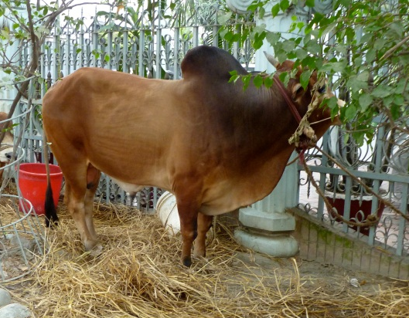
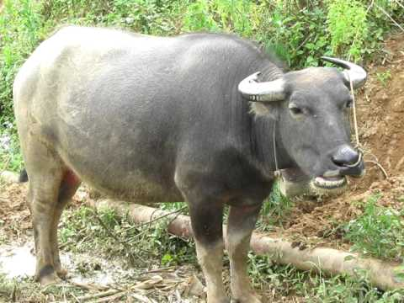
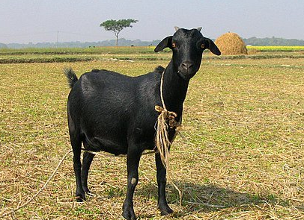
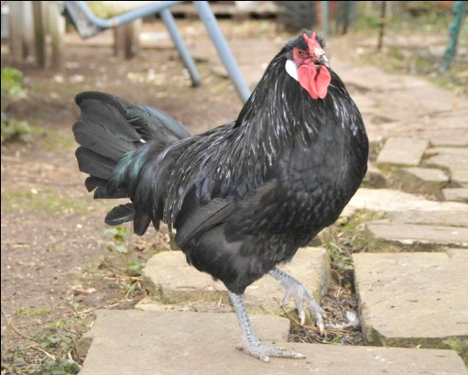
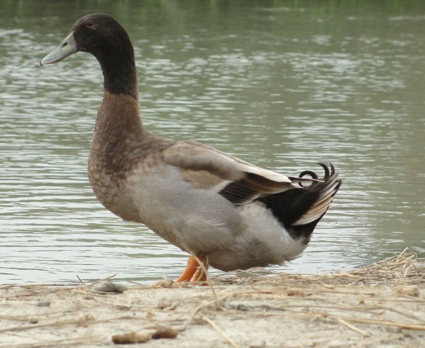

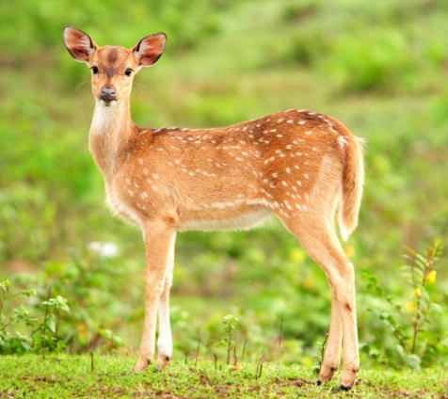
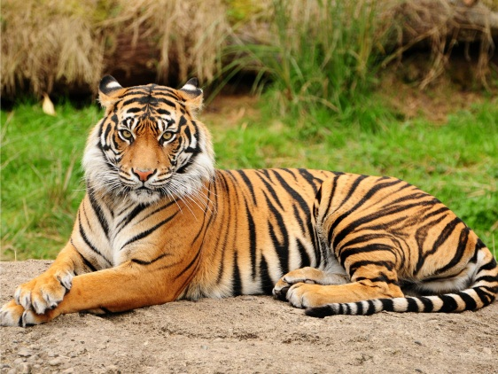
Fauna
(Noun)
These animals are the fauna of Bangladesh.
The animals of a particular region.

Slide 18

Sprightly
(Adjective)
The baby is very sprightly.
Cheerful

Slide 19

Pleasant
(Adjective)
The scenery looks very pleasant.
Attractive

Slide 20
Read the passage about ‘Benebau’ from the text book and write the answer of the following questions.
1. What are we proud of?
Ans: We are proud of our soil, forest, fruits and birds.
2. In which countries is Blackheaded Oriole seen?
Ans: It is seen in Bangladesh, India, Srilanka, Mayanmar and some countries .
3. How is its call?
Ans: Its call is sweet and pleasant.
Notes:
The teacher can ask SS to go to the textbook. After reading the passage student will find out the answer from the passage. 10 minutes can be given for the task. Then the teacher can elicit answer from 4/5 students. Then the teacher can show the answer.

Slide 21
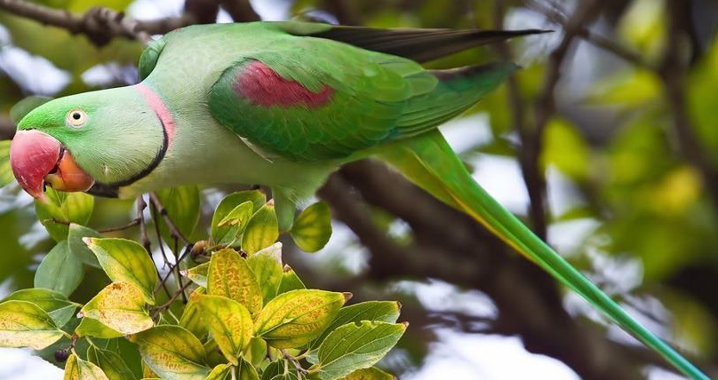
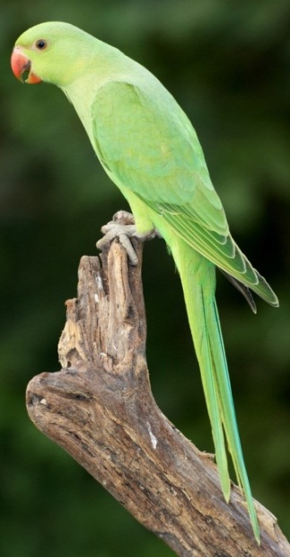
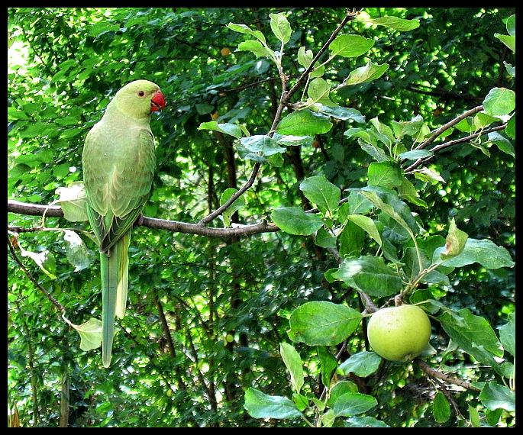
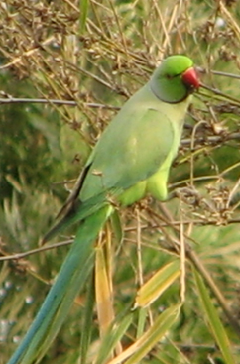
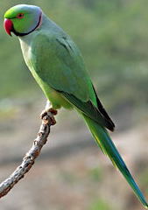
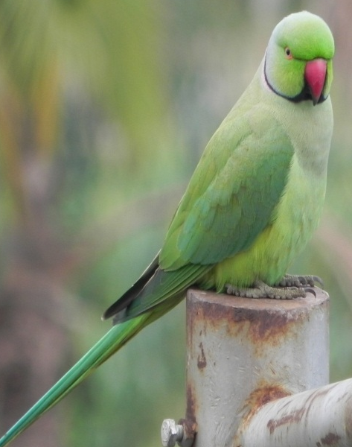
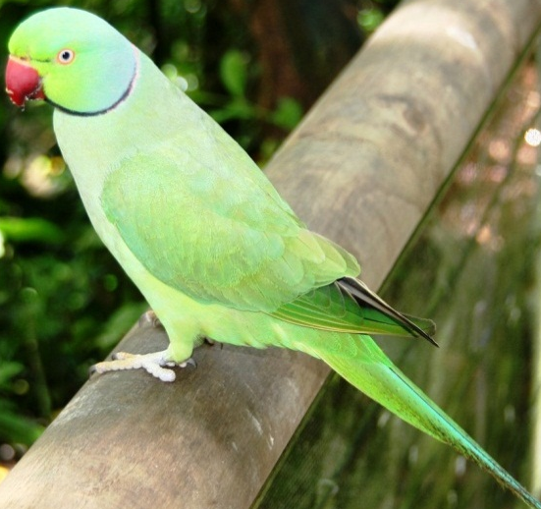
‘Tia’ (Parrot)
Can you tell the name of the bird?

Slide 22
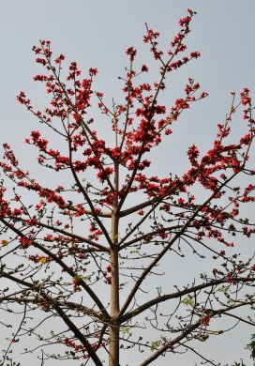
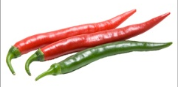
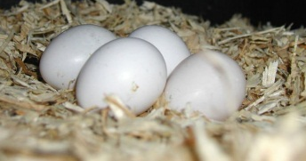

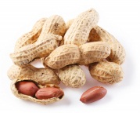
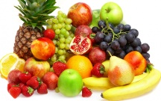
Look at the bird ‘Tia’ and write a paragraph on it using the clues given.
black and red coloured rings around its neck
yellow and round eyes
strong, curved red beak
whole body green
tall, slim tail
feet red
makes nest in Shimul tree
found all over Bangladesh
42 cm length
Eats grass, nuts, chilli and fruits
lays four or six eggs

Slide 23




Please don’t cut trees.
Let us live happily and peacefully.

Slide 24
Acknowledgement
MoE, DSHE, NCTB & A2I respective of officials
And the editors panel: Ranjit Poddar, Associate Professor (English) TTC, Dhaka, Md. Jahangir Hasan (English), Assistant Professor TTC, Rangpur and Urmila Khaled Assistant Professor (English) TTC, Dhaka.
Their direction, valuable suggestions and intensive supervision have enriched the model contents.

Slide 25

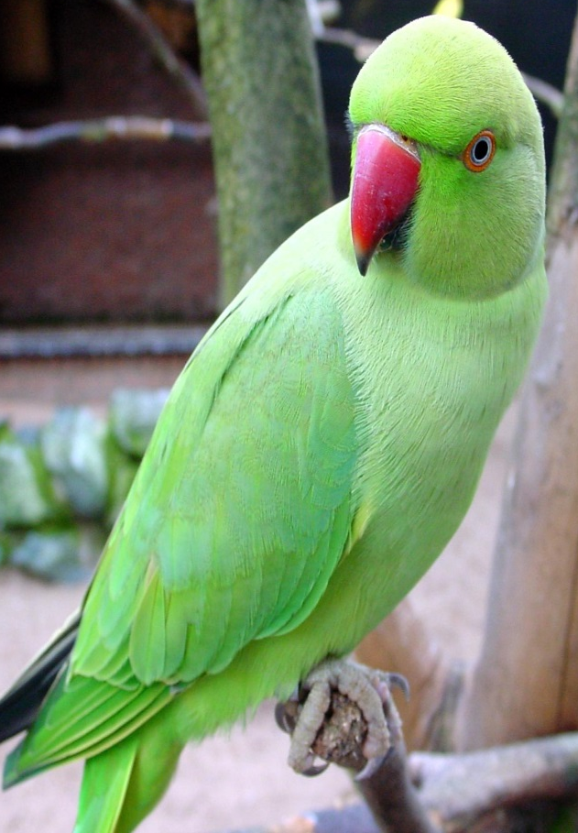
Thank you all

